Slide 1
Issue Tracking
Usage & Best Practices

Slide 2
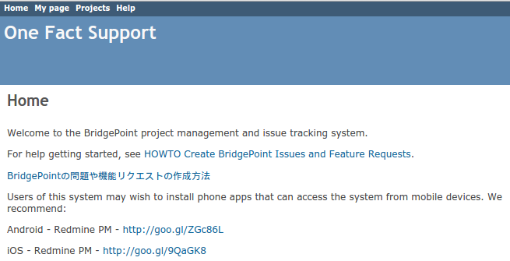
Getting Started with ServicePro
http://support.onefact.net
Help instructions in English and Japanese available on the Home page

Slide 3
Terms
DEI = Defect, Enhancement, Issue
SR = Service Request
DEIs are public, SRs are private

Slide 4
Organizing DEIs
One Fact creates a publicly-visible DEI for an SR (or part of an SR) that is being worked on
Add new issue to the proper subproject of BridgePoint
Don’t fret if DEI starts in the wrong subproject. DEIs are easy to move later.

Slide 5
Is it an Issue or Not?
Is it a bug? a feature? an idea? … Nobody cares
Key is to raise an issue!
Benefits:
Creates a historical record
Facilitates discussion among community members
Allows for roadmap placement
Helps identify error clusters

Slide 6
What to Capture?
Contents of an issue should include:
Detailed description of Failure Mode
Steps to reproduce failure
Data associated with reproducible case can be attached to the issue using the “Files” section
Steps to workaround failure (if known)
Priority for resolving issue. Not all failures require Critical priority.
List versions of BridgePoint demonstrate issue (Affected Versions)

Slide 7
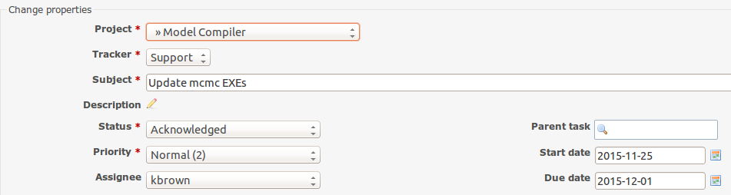
Updating an Existing Issue
Move issue from one project to another
Update the description… Click the pencil!
Change status

Slide 8
When Starting on a DEI
Set Assignee to self
Set Status to “In Progress”
Set a Due Date!
Can be adjusted later
Developers need a target to shoot for
Check Inbox for Email notifications

Slide 9
Once Started on a DEI
A Core Team member
May set estimated time
May assign a target version
May set a reviewer
Email notifications are sent after each change in DEI is submitted

Slide 10
E-mail into ServicePro
The content of the body of the e-mail is added as a new note
Mail To: issues@onefact.net
Subject: [#<issuenum>] <text>

Slide 11
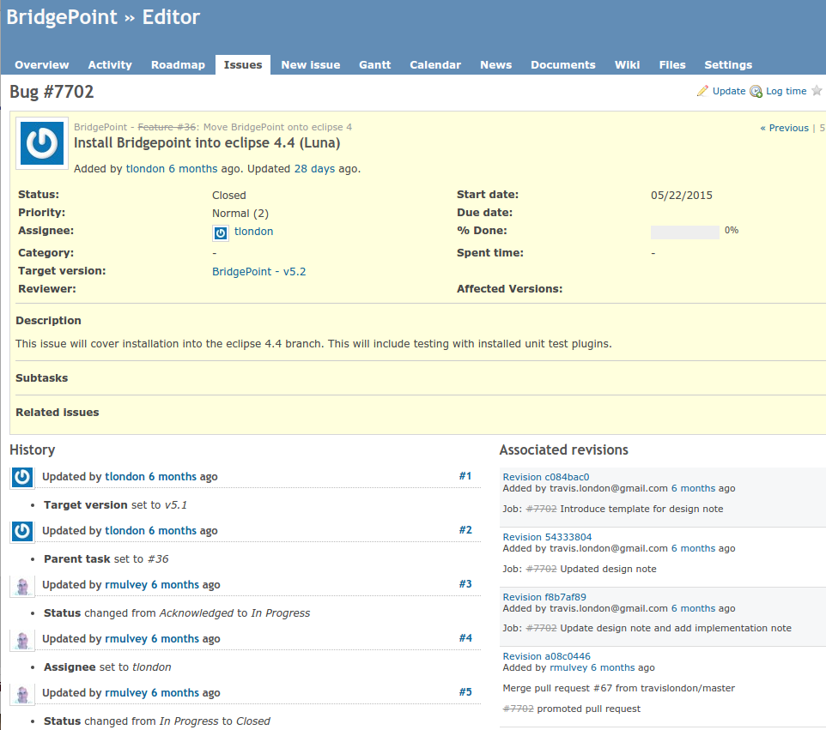
Requirements Tracing
Revision control commits with description “job #<issuenum> - <text>” are added to the issue after promotion
Ties the issue tracker and code changes together

Slide 12
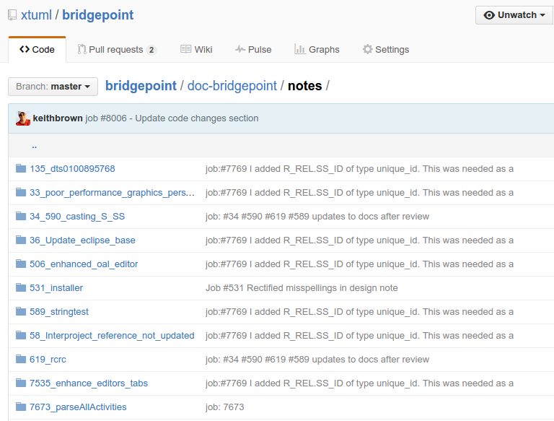
Requirements Tracing
Development documentation is named with a specific issue number

Slide 13
Test Cases as “Issues”
The xtUML development team maintains manual system tests
Each test includes detailed instructions and points at the data/model used during the test
We can easily set which tests are to be run during a test cycle
This system automatically maintains a list of the test outcomes for each test cycle.

Slide 14
Queries
Running queries
Be careful about what project you are in when you run a query. By default queries apply to the project and subprojects of where you are currently at.
Roadmap queries
How the xtUML Dev Team manages the Roadmap
Creating queries

